Slide 1





GALE: Geometric active learning for Search-Based software Engineering (a “Journal First” paper for FSE’15)
Joseph Krall Tim Menzies Misty Davies
tim.menzies@gmail.com
Sept 4, 2015

Slide 2

Roadmap
Journal-first
GALE
strong force to push you around
Search-based SE
The future of SE
Why we explore with GALE
Geometric
Look before you leap
Peek at topology b4 making inference
Active learning:
Scoring examples costs X.
Minimize sum of X

Slide 3
Roadmap
Journal-first
GALE
strong force to push you around
Search-based SE
The future of SE
Why we explore with GALE
Geometric
Look before you leap
Peek at topology b4 making inference
Active learning:
Scoring examples costs X.
Minimize sum of X

Slide 4
Journal first: useful for jumping communities e.g. me, 12 years, 12 TSE articles, 8 journal first
2015 (to appear):
GALE: Geometric active learning for Search-Based software Engineering, Krall, Menzies, Davies
2013:
Learning Project Management Decisions: A Case Study with Case-Based Reasoning versus Data Farming, Menzies, Brady, Keung, Hihn, Steven Williams, El-Rawas, Green, Boehm
Balancing Privacy and Utility in Cross-Company Defect Prediction, Peters, Menzies, Gong, Zhang
Active Learning and Effort Estimation: Finding the Essential Content of Software Effort Estimation Data Kocaguneli, Menzies, Keung, Cok, Madachy
Local versus Global Lessons for Defect Prediction and Effort Estimation, Tim Menzies, Butcher, Cok, Marcus, Layman, Shull, Turhan, Zimmermann
2012:
On the Value of Ensemble Effort Estimation, Kocaguneli, Menzies, Keung
Exploiting the Essential Assumptions of Analogy-Based Effort Estimation, Kocaguneli, Menzies, Bener, Keung
2011:
Gas for Randomized Unit Testing, Andrews, Menzies, Felix Li
2007:
Problems with Precision: A Response to "Comments on 'Data Mining Static Code Attributes to Learn Defect Predictors’”, Menzies, Dekhtyar, Distefano, Greenwald
Data Mining Static Code Attributes to Learn Defect Predictors, Menzies, Greenwald, Frank
2006:
Best Practices for Effort Estimation, Menzies, Chen, Hihn, Lum
2003:
More Success & Failure Factors in Software Reuse, Menzies, Stefano

Slide 5
Roadmap
Journal-first
GALE
strong force to push you around
Search-based SE
The future of SE
Why we explore with GALE
Geometric
Look before you leap
Peek at topology b4 making inference
Active learning:
Scoring examples costs X.
Minimize sum of X

Slide 6
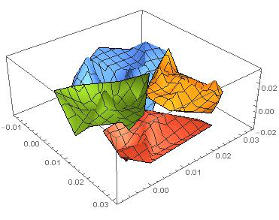
GALE force
Approximate the space
k=2 divisive clustering
Evaluate 2 distant points (X,Y) per cluster
If better(X,Y)
If size(cluster) > large
Cut in two
Recurse on better half
Else, push points towards X
e.g. orange points get pushed this way

Slide 7
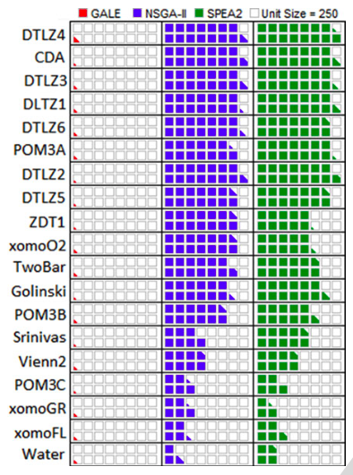
Evaluations per generation: GALE = O(log(N)); Others = O(N)
RQ1:
Is GALE slow ?
all that clustering
RQ2:
Is GALE effective?
evals 2 points per cluster

Slide 8
Roadmap
Journal-first
GALE
strong force to push you around
Search-based SE
The future of SE
Why we explore with GALE
Geometric
Look before you leap
Peek at topology b4 making inference
Active learning:
Scoring examples costs X.
Minimize sum of X

Slide 9
Q: What comes next, after “big data”? A: “Big model” • After collecting all that data • We are going to use it to build models.

Slide 10
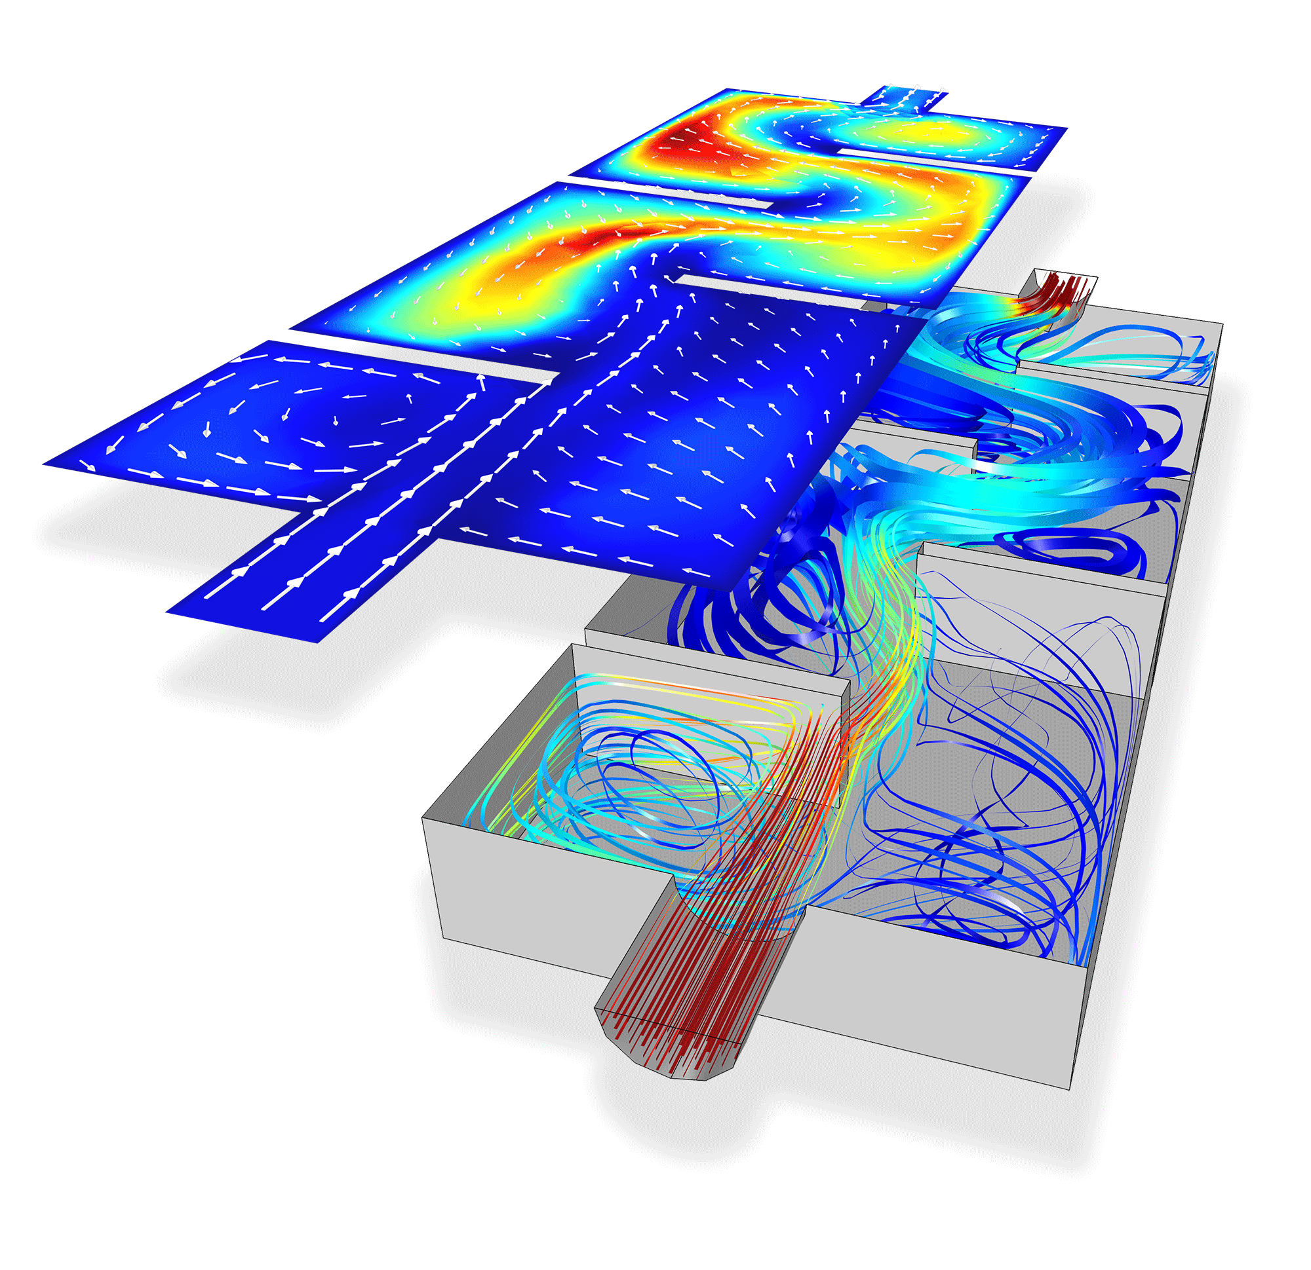
Models are everywhere
If you call an ambulance in London or New York,
those ambulances are controlled by emergency response models.
If you cross the border Arizona to Mexico,
A models determines if you are taken away for extra security measures.
If you default on your car loans,
A model determines when (or if) someone to repossess your car.
If the stock market crashes,
it might be that some model caused the crash.

Slide 11
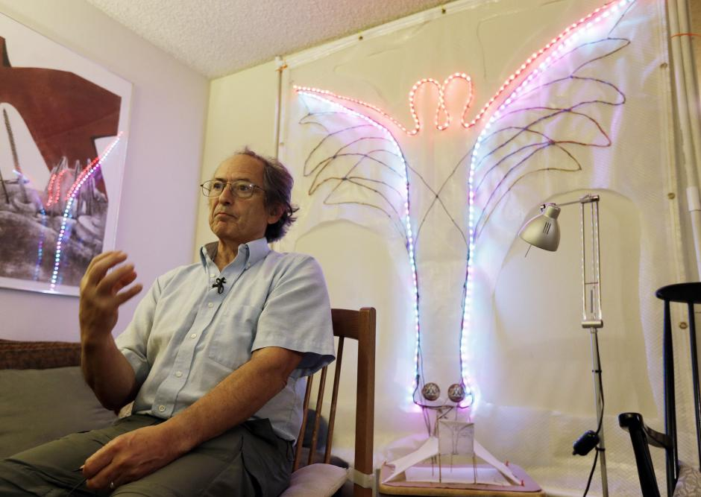
Models are everywhere
Models are now a central tool in scientific research.
in physics, biology and other fields of science
complex simulations using supercomputers.
E.g. genomic map required analyzing 80 trillion bytes
E.g.. Other computational modeling projects
the rise and fall of native cultures,
subnuclear particles
the Big Bang.
Karplus and Levitt
2013 Nobel prize in chemistry
development of multi-scale models for complex chemical systems
Explored complex chemical reactions (e.g. split-second changes of photosynthesis).

Slide 12
Search-based SE
﻿Many SE activities are like optimization problems [Harman,Jones’01].
Due to computational complexity, exact optimization methods can be impractical for large SBSE problems
So researchers and practitioners use metaheuristic search to find near optimal or good-enough solutions.
E.g. simulated annealing [Rosenbluth et al.’53]
E.g. genetic algorithms [Goldberg’79]
E.g. tabu search [Glover86]

Slide 13
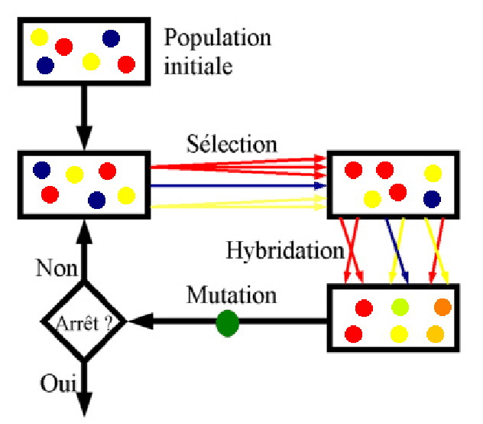
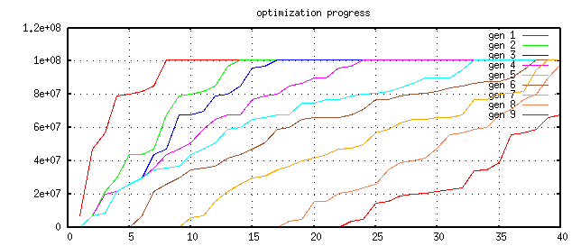
Optimization and evolutionary algorithms
Repeat till happy or exhausted
Selection (cull the herd)
Cross-over (the rude bit)
Mutation (stochastic jiggle)
Pareto frontier
-- better on some criteria, worse on none
Selection:
-- generation[i+1] comes from Pareto frontier of generation[i]
9
8
7
6
5
4
3
2
1

Slide 14
Applications of Optimization in SE
1. Requirements Menzies, Feather, Bagnall, Mansouri, Zhang
2. Transformation Cooper, Ryan, Schielke, Subramanian, Fatiregun, Williams
3.Effort prediction Aguilar-Ruiz, Burgess, Dolado, Lefley, Shepperd
4. Management Alba, Antoniol, Chicano, Di Pentam Greer, Ruhe
5. Heap allocation Cohen, Kooi, Srisa-an
6. Regression test Li, Yoo, Elbaum, Rothermel, Walcott, Soffa, Kampfhamer
7. SOA Canfora, Di Penta, Esposito, Villani
8. Refactoring Antoniol, Briand, Cinneide, O’Keeffe, Merlo, Seng, Tratt
9. Test Generation Alba, Binkley, Bottaci, Briand, Chicano, Clark, Cohen, Gutjahr, Harrold, Holcombe, Jones, Korel, Pargass, Reformat, Roper, McMinn, Michael, Sthamer, Tracy, Tonella,Xanthakis, Xiao, Wegener, Wilkins
10. Maintenance Antoniol, Lutz, Di Penta, Madhavi, Mancoridis, Mitchell, Swift
11. Model checking Alba, Chicano, Godefroid
12. Probing Cohen, Elbaum
13. UIOs Derderian, Guo, Hierons
14. Comprehension Gold, Li, Mahdavi
15. Protocols Alba, Clark, Jacob, Troya
16. Component sel Baker, Skaliotis, Steinhofel, Yoo
17. Agent Oriented Haas, Peysakhov, Sinclair, Shami, Mancoridis

Slide 15
Roadmap
Intro
Why use search-based methods?

Slide 16
But why do we care?

Slide 17
Researech questions
RQ1:
Is GALE slow due to all that clustering
RQ!:
Is GALE effective:

Slide 18
Related work
Multi-objective optimization
MOEA/D : R random directions, uses N eval/gen
GALE: informed directions, log(N) evals/gen
Active learning:
In SE, have not see this applied before MOEA
Response surface methods
Parametric approximations of topology
Avoids slow evals of model
Use approximation instead
GALE:
no parametric assumptions
V.simple approximation
Local search
Some work in MOEA
None known (to us) in SE
? Needs more than log(N) evals

Slide 19
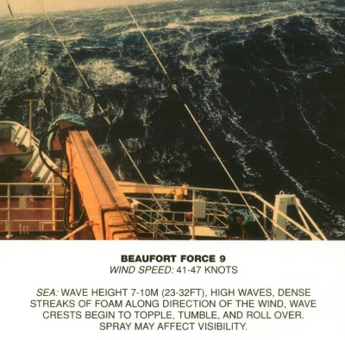
GALE : a strong wing

